Slide 1
Discovering Your Roots
Basic Record Types and Strategies
Nicole Dyer
FamilyLocket.com

Slide 2
Family History You can find extraordinary things about ordinary people.
Discovery awaits!

Slide 3
Where Will You Build Your Tree?
Option | Price | Features
FamilySearch.org | Free | One big collaborative public tree, many record hints, mobile app
Ancestry.com | Subscription required. Free trial available. Search records free at library/school | Private and public tree options, many record hints, mobile app
MyHeritage.com | Free | Personal family tree, free downloadable program, many records, mobile app

Slide 4
How to Begin
Choose
Choose with a deceased great-grandparent to start with
Find
Find basic records about them
Census
Birth, marriage, death certificates
Record
Record the information in your family tree

Slide 5
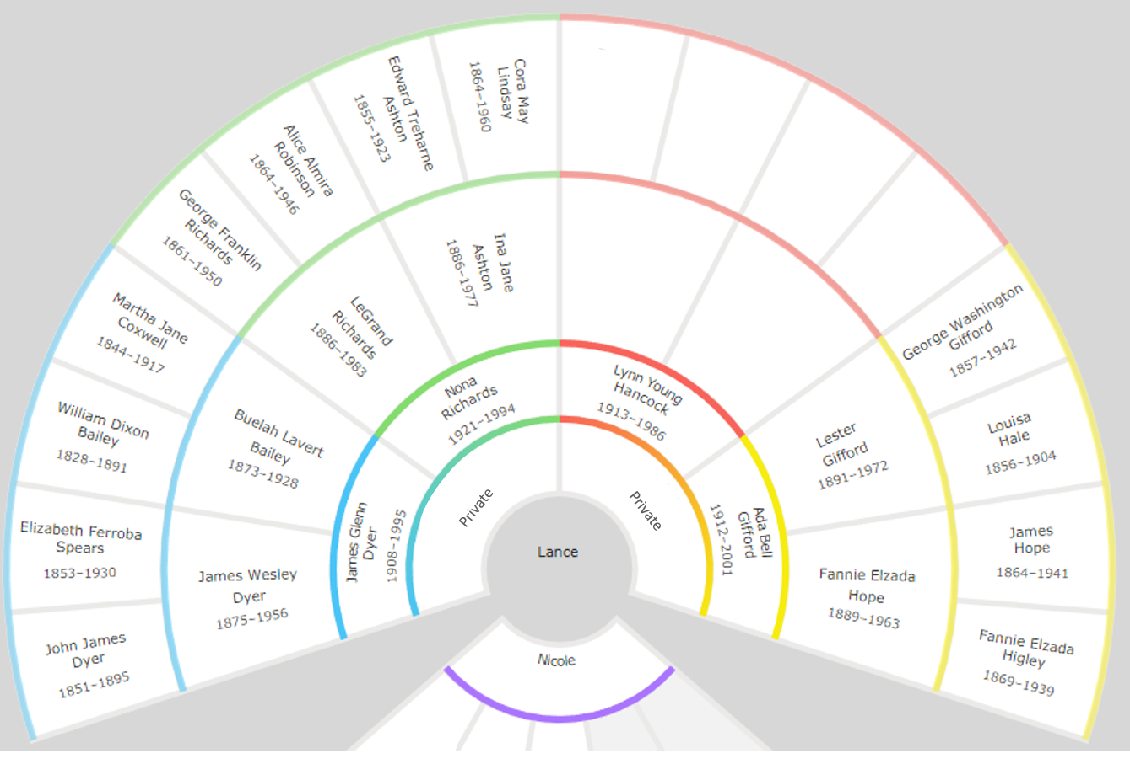
Choose a Person to Start With
Lance’s family tree
Choose one of his grandparents to start with
What would you like to know?

Slide 6
Lynn Young Hancock
Know:
Birth year: 1913 in Arizona
Death year: 1986 in Oregon
Wife: Ada Bell Gifford
Want to Know:
Parents names
Specific birth and death dates and places
When and where married
Any interesting facts about his life
Lance’s mother’s father

Slide 7
How to Know if Information is Accurate
Information
Primary: eyewitness account
Secondary: heard from someone else
Unknown: don’t know the informant
Source
Original: first record of an event
Derivative: index, transcription
Authored: original work

Slide 8
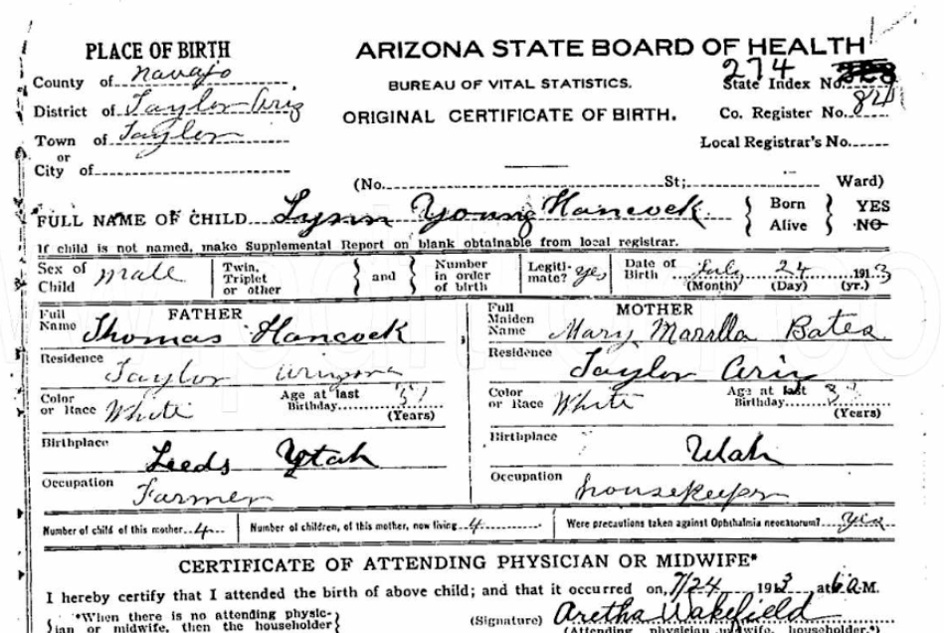
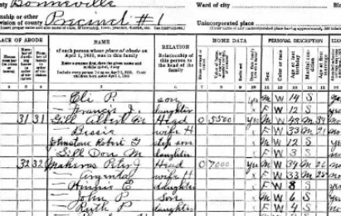
Original Sources
Birth Record
Marriage Record
Death Record
Cemetery Record
Census Records
Military Records
Usually created by a county government office, federal government, church, cemetery, etc.

Slide 9
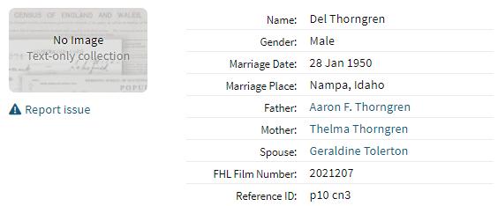
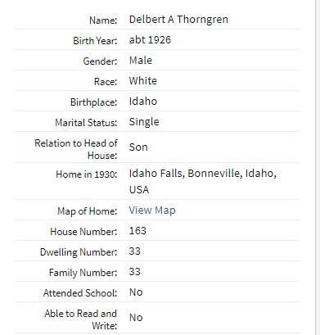
Derivative Sources
Database of Births Online
Social Security Death Index
Census Transcription
Usually created by a genealogy website, company, historical society, library

Slide 10
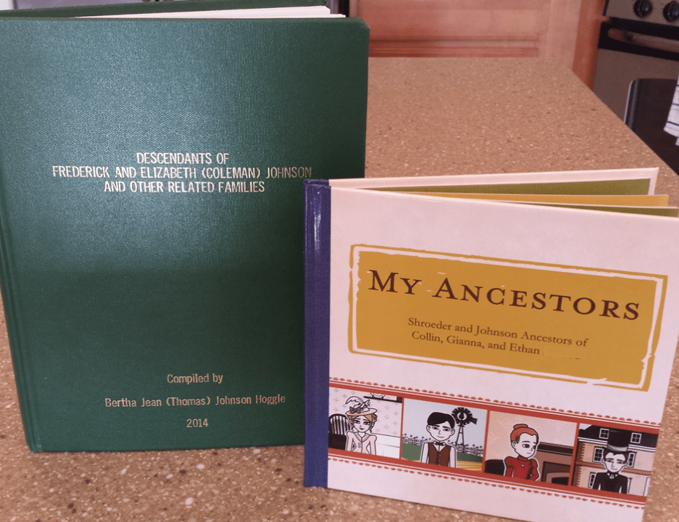
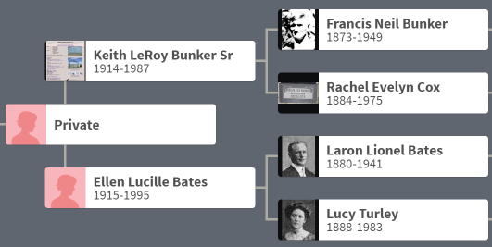
Authored Sources
Family Trees published online
Family History Books
Biography
Report
Usually created by an individual – researcher, author, etc.

Slide 11
Original Records are Best!
First record created of an event
Less reliant on memory
Often tell the truth more reliably

Slide 12
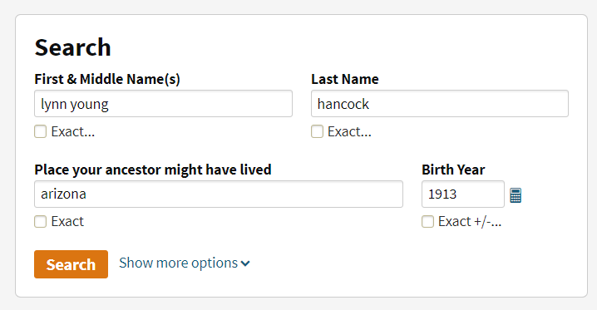
Find Lynn on an Original Record
Ancestry.com
Name: Lynn Young Hancock
Birth year: 1913
Birth place: Arizona

Slide 13
Which birth record should we look at – the one with an image, or without?

Slide 14
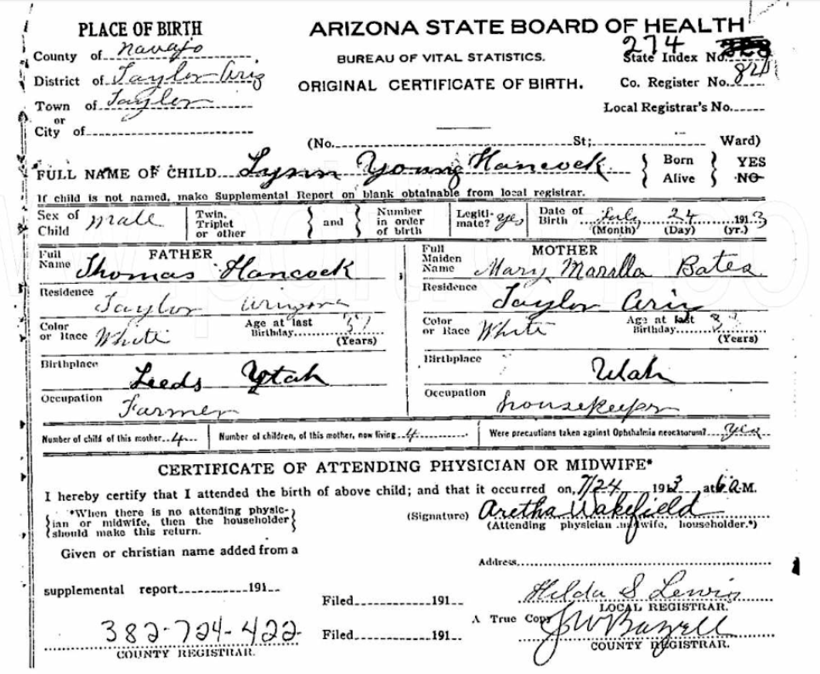
Birth Certificate New information learned
Before you add this to your pedigree…

Slide 15
Standard Formats for Genealogy Info
Dates
Day, month, year
24 July 1913
Places
City, County, State, Country
Taylor, Navajo, Arizona, USA

Slide 17
Birth Certificate New information learned
Birthplace: Taylor, Navajo County, Arizona
Birthdate: 24 July 1913
Father: Thomas Hancock, born in Leeds, Utah
Is Leeds a town or county?
Search Google for Leeds, Utah
Mother: Mary Marilla Bates, born in Utah

Slide 18
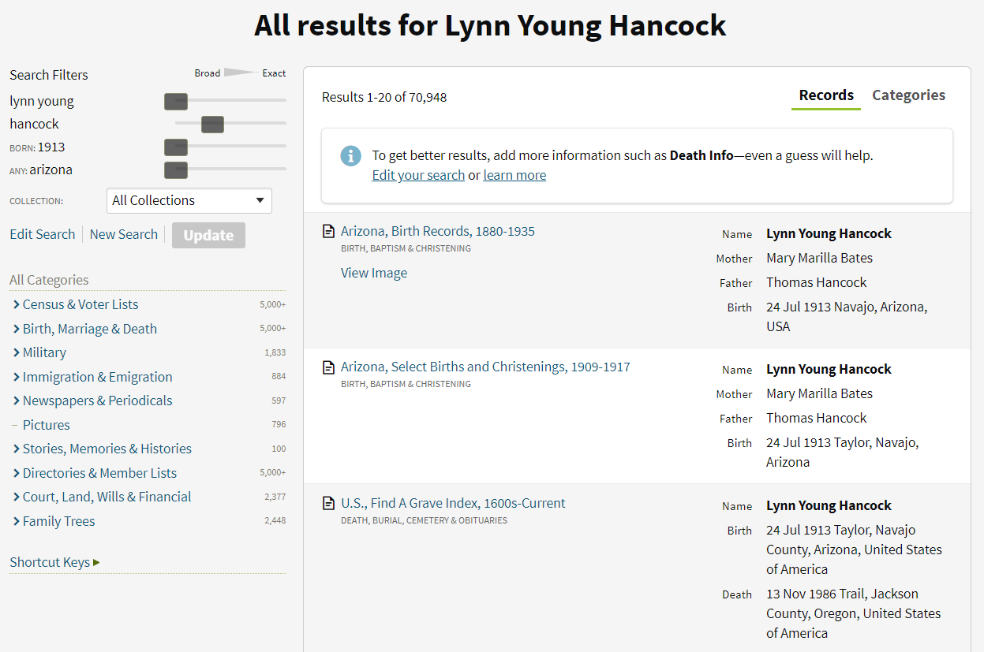

Slide 19
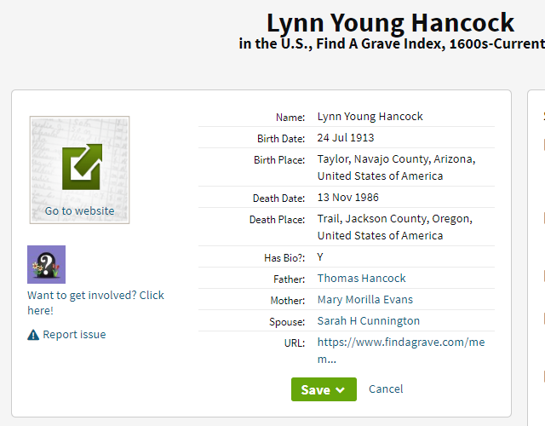
Find A Grave Index New information learned
Death date 13 Nov 1986
Death place Trail, Jackson County, Oregon
Mother’s name: Mary Morilla Evans?
What is the source of this information?

Slide 20
Leeds, Washington, Utah

Slide 21
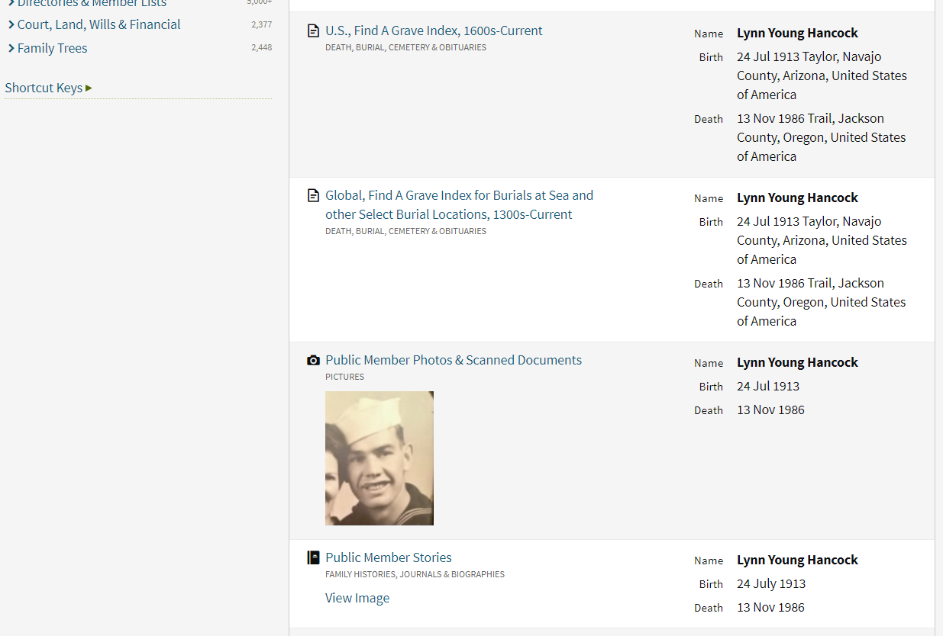

Slide 22
Photo
What clues does this photo give us?
Clothing
People
Time period

Slide 23
Public Member Stories
What type of Source?
Original
Derivative
Authored

Slide 24
Find an Original Record to Corroborate
Narrow Ancestry search by Military records
Search Google
“Lynn Young Hancock” Fold3
“Lynn Young Hancock” FamilySearch

Slide 25
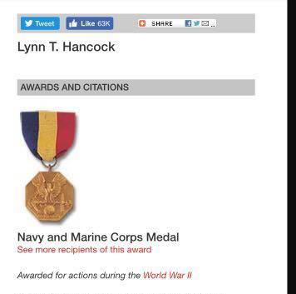
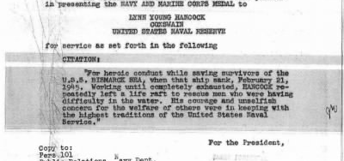
Ordinary people, Extraordinary lives
Medal of honor
Courage, unselfish concern for welfare of others
Letter from the president

Slide 26
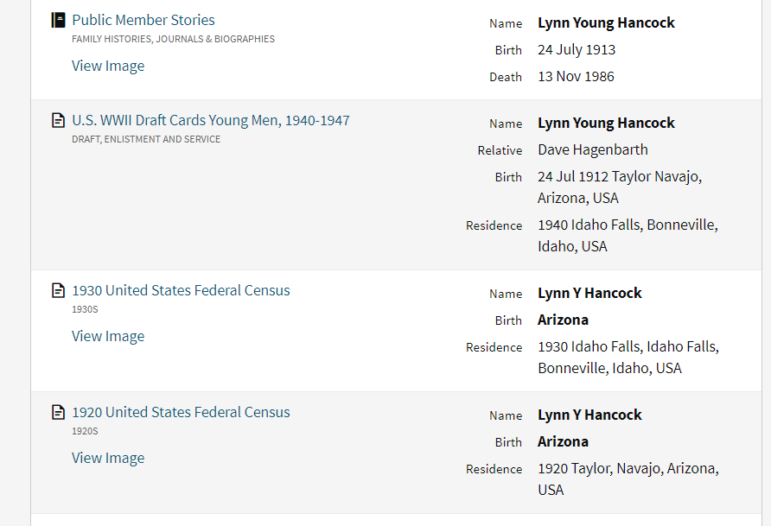

Slide 27
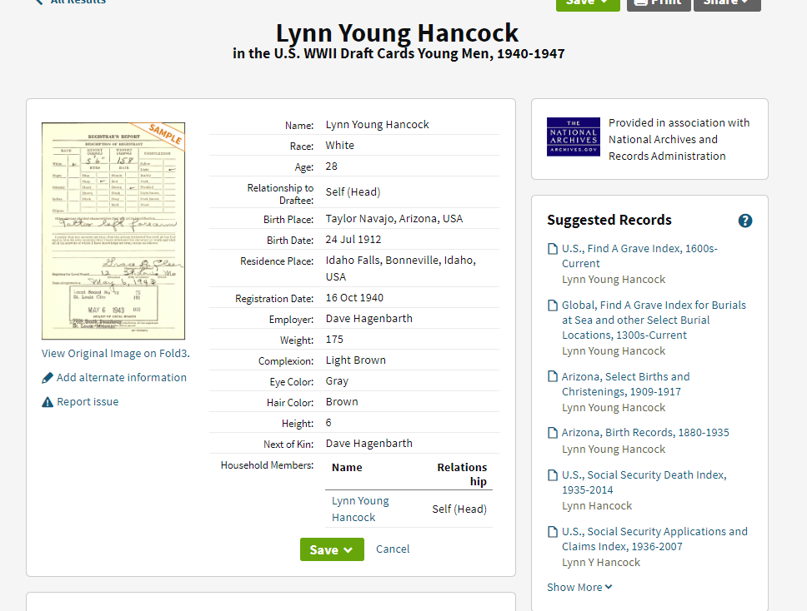
Why do you think his birth year is listed incorrectly?
Was Lynn an eyewitness to his own birth? Or is this secondary information?

Slide 29
1920 Census

Slide 31
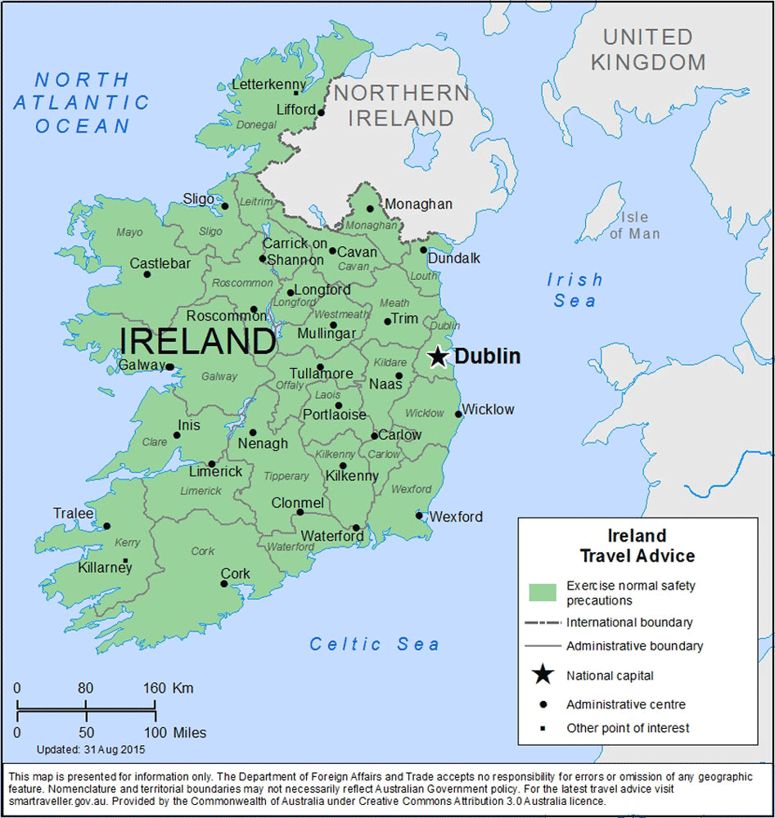
1920 Census Extra Info in the Census Image
Do the Hancocks own their home or rent?
Birthplaces of Thomas Hancock’s parents?

Slide 33
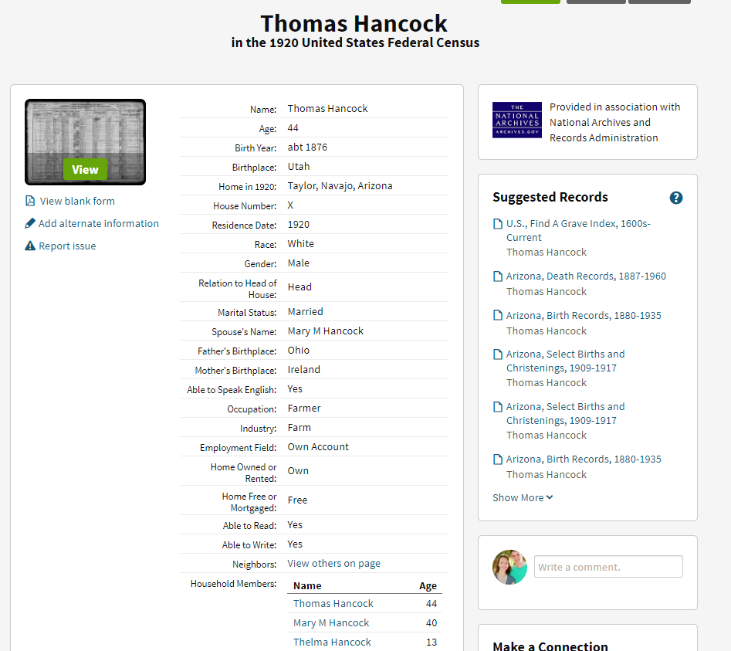
Add the new information to your pedigree chart

Slide 34
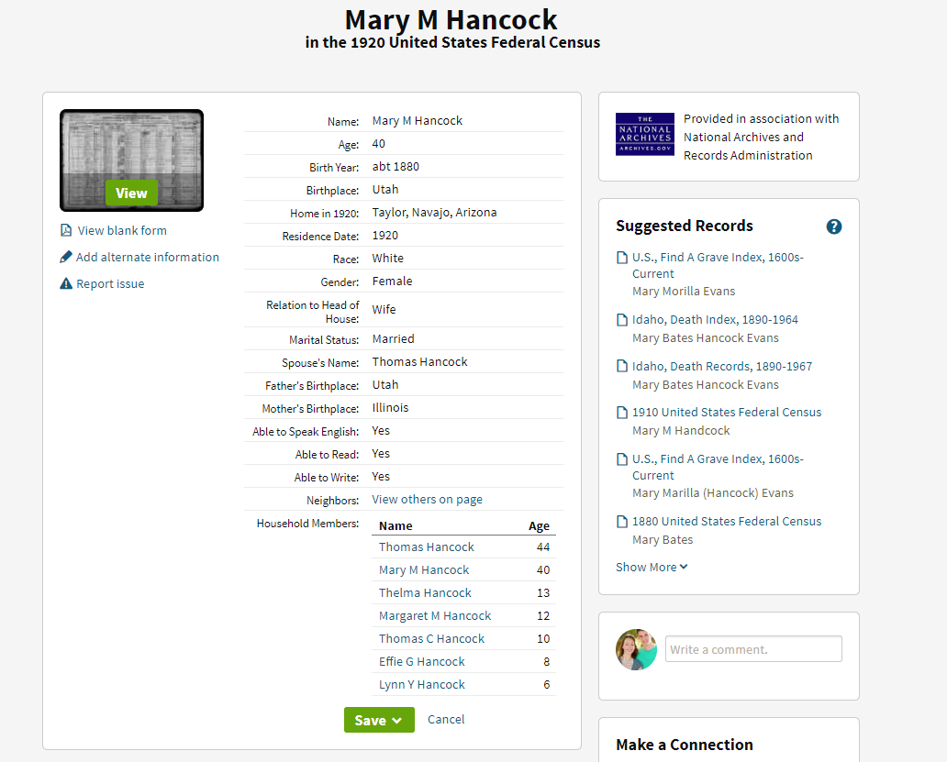
Add the new information to your pedigree chart

Slide 35
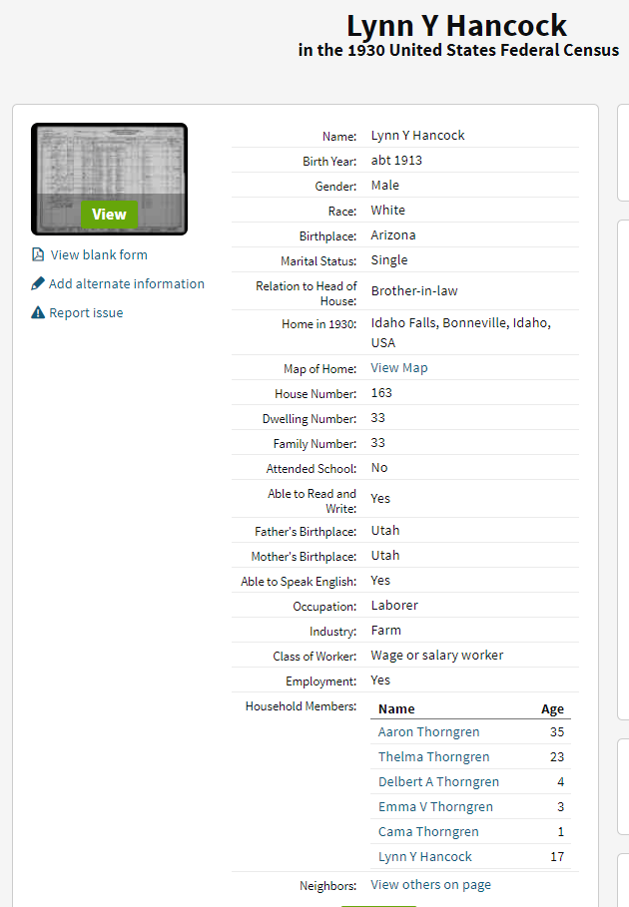
1930 Census

Slide 36
Questions that Arise from the Records
Why is Lynn living with his sister at age 17?
What happened to Lynn’s parents?
Let’s search for Thomas Hancock, Lynn’s father.

Slide 37
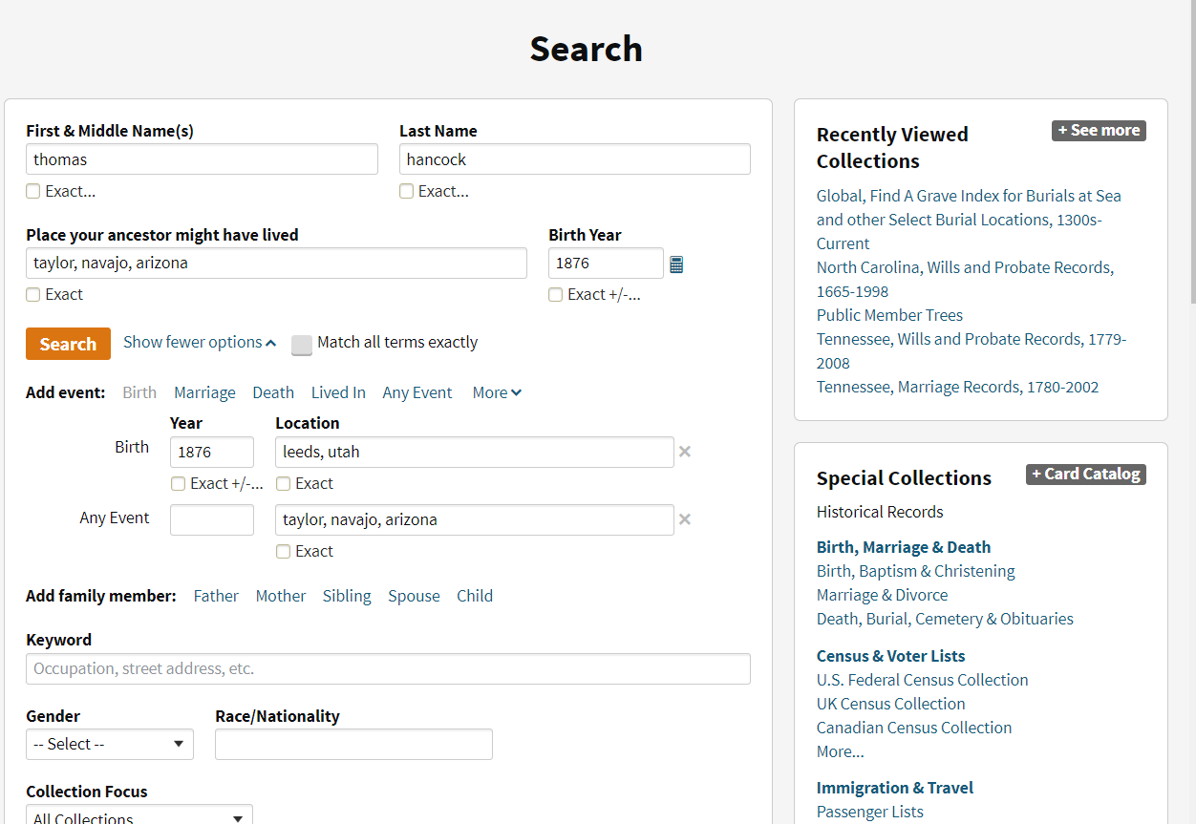

Slide 38
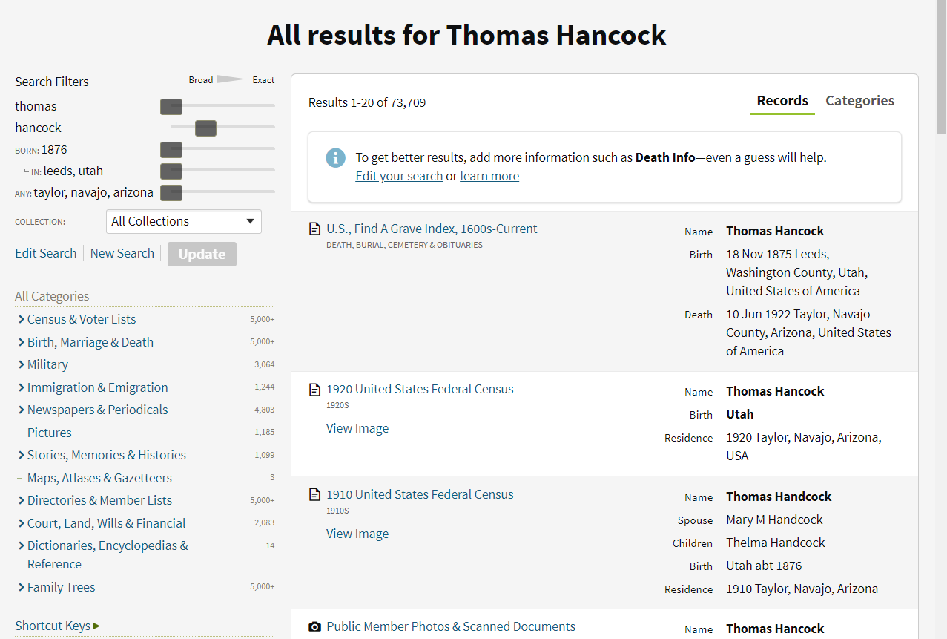
Thomas’ Death
Thomas died before 1930, when Lynn was only 10. That’s partly why Lynn was living with his sister in 1930.
“Handcock”
Names will be spelled differently on different records. Don’t be too surprised to see spelling variants!

Slide 39
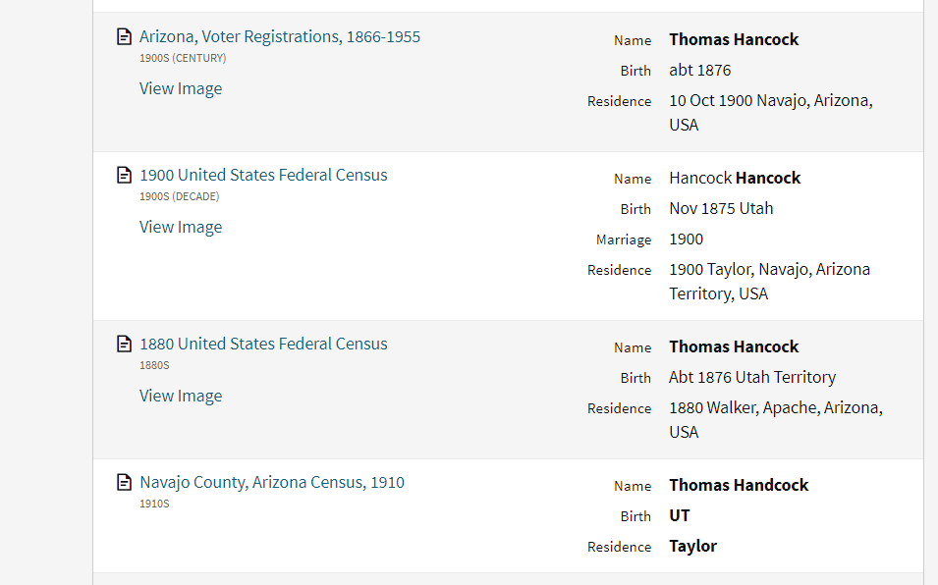

Slide 40
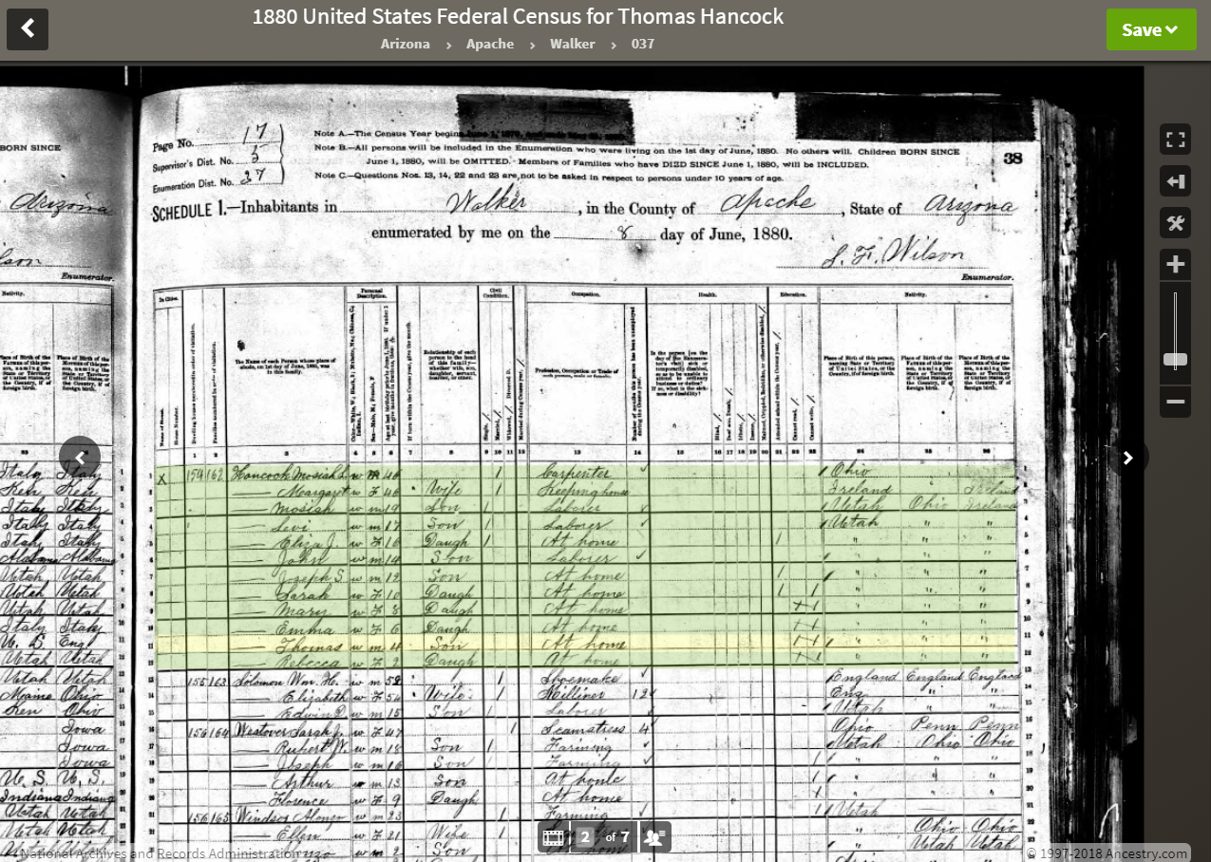

Slide 41
Censuses How do I know if this record matches my ancestor?
Compare unique information
Combining all the unique information about a person forms a unique identity for them, like a fingerprint
The more details you know, the better
The more specific your details, the better

Slide 42
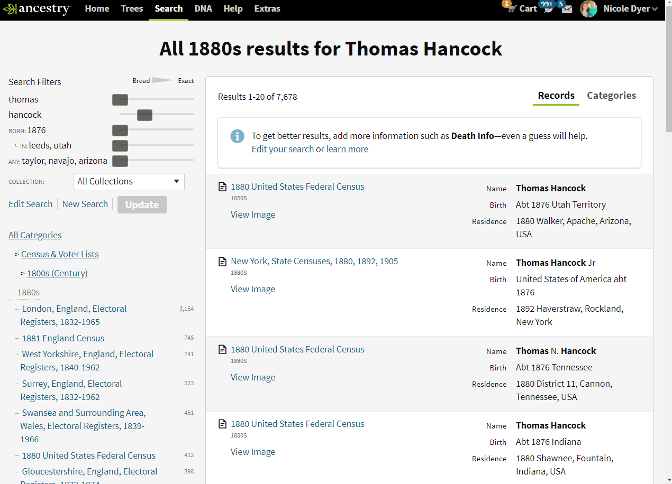

Slide 43
1880 Census Thomas Hancock, Walker, AZ
Detail | What We Know | What the Record Shows
Name | Thomas Hancock | Thomas Hancock
Birth Year | 1876 | 1876
Birth Place | Leeds, Utah | Utah Territory
Residence | Taylor, Navajo, Arizona | Walker, Apache, Arizona
Parents’ Birthplaces | Ohio Ireland | Ohio Ireland
Relatives | Mom: ? Dad: ? Spouse: Mary Marilla Bates | Mom: Margaret Hancock Dad: Mosiah Hancock Spouse: ?
Occupation | Farmer | At home
Match!

Slide 44
1880 Census Thomas Hancock, Silver Reef, Utah
Detail | What We Know | What the Record Shows
Name | Thomas Hancock | Thomas Hancock
Birth Year | 1876 | 1862
Birth Place | Leeds, Utah | Utah Territory
Residence | Taylor, Navajo, Arizona | Silver Reef, Washington, Utah
Parents’ Birthplaces | Ohio Ireland | Illinois England
Relatives | Mom: ? Dad: ? Spouse: Mary Marilla Bates | Mom: ? Dad: ? Spouse: ?
Occupation | Farmer | Wood chopper
Not a Match

Slide 45
Be Careful When Matching Records to your Ancestor!
People of the same name
People with very similar information
The most unique identifiers can be other people: spouse, children, etc.

Slide 46
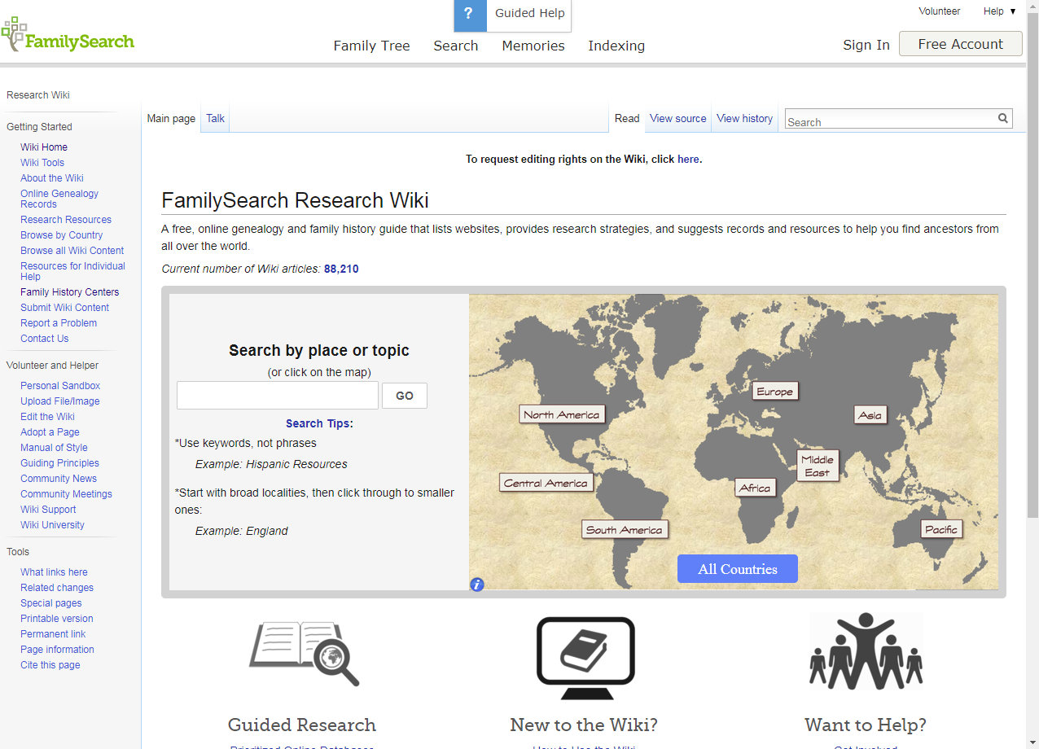
Learn to Research in any Place
FamilySearch Wiki
Encyclopedia for family history research
https://www.familysearch.org/wiki/en/Main_Page

Slide 47
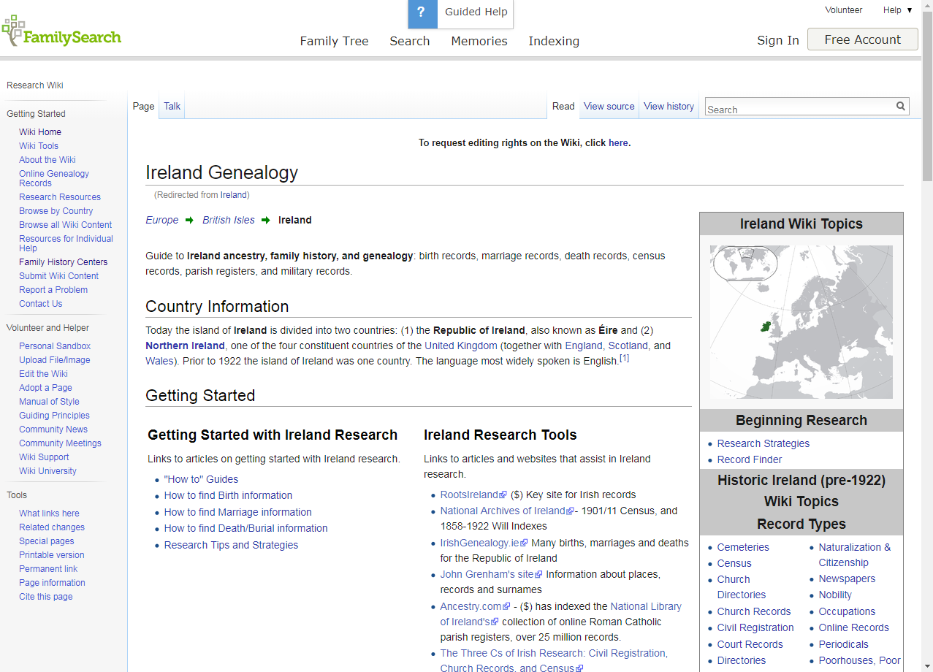
Wiki Article for Ireland
Links to specific record groups
How to find birth information, etc.
Links to websites that can help

Slide 48
Wiki Article for United States Newspapers
Websites to find digitized newspapers
What you can find about your ancestors in newspapers

Slide 49
Good Luck!
Don’t give up
Try different search combinations
Continue learning about records and research strategies

